Slide 1
Find Best Neighborhood in Shanghai to Build Electrical Vehicle Charging Station
BY Shuhao Constan Chang

Slide 2
1. Introduction and background
A real problem I met when I was an intern
Our company need to make decisions to select two neighborhoods as the first stage of building stations plan

Slide 3
(Con’t) Feature of Electrical charging
Charging a vehicle takes far longer time that filling gas to a car
A 90% charging process will usually take more than 4 hours
But filling gas only takes less than 10 mins.
Electrical charging stations are much larger than gas stations
Since a lot of cars need to be charged at the same time.

Slide 4
(Con’T) characteristics of an idea place to build an electrical vehicle charging stations
People tend to choose drive to this location.
People usually stay at this neighborhood for more than 4 hours once (shopping, traveling and hoteling are typical activities for longer stay).
The neighborhood should not be in but near the downtown area, which is feasible and cheap to find an open area to build a large station.

Slide 5
2. The data and information used for analyzing
The divisions and neighborhoods of Shanghai
These data and information will be scraped from Wikipedia web page
https://en.wikipedia.org/wiki/Category:Neighbourhoods_of_Shanghai
Geographical coordinates (Latitude and longitude) data of each neighborhood
This data is import from Geocoder library
https://geocoder.readthedocs.io/
Venues data in each neighborhood.
This data is acquired from Foursquare API
https://foursquare.com/

Slide 6
3.Methodology and Main Components

Slide 7
3.1 Install and Import Libraries
Beautifulsoup4, geocoder, numpy, pandas, json_ _normalize, geopy, requests, matplotlib, sklearn-Kmeans, folium, geocoder

Slide 8


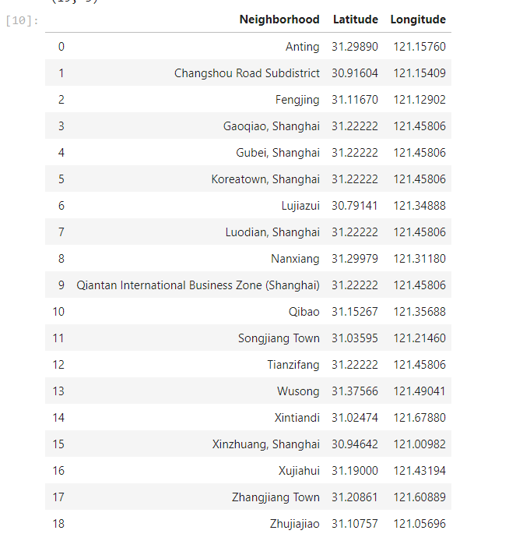
3.2 Build a dataframe of neighborhoods in Shanghai, China by web scraping (BeautifulSoup) the data from Wikipedia page

Slide 9
3.3 Get the geographical coordinates (Geocoder) of the neighborhoods and build a map with neighborhoods
Define a function to get coordinates, initialize variable to None and loop until getting the coordinates.
Create temporary data frame to populate the coordinates into Latitude and Longitude.
Merge the coordinates into the original data frame.
Check the neighborhoods and the coordinates and finally create map of Shanghai using latitude and longitude values

Slide 10
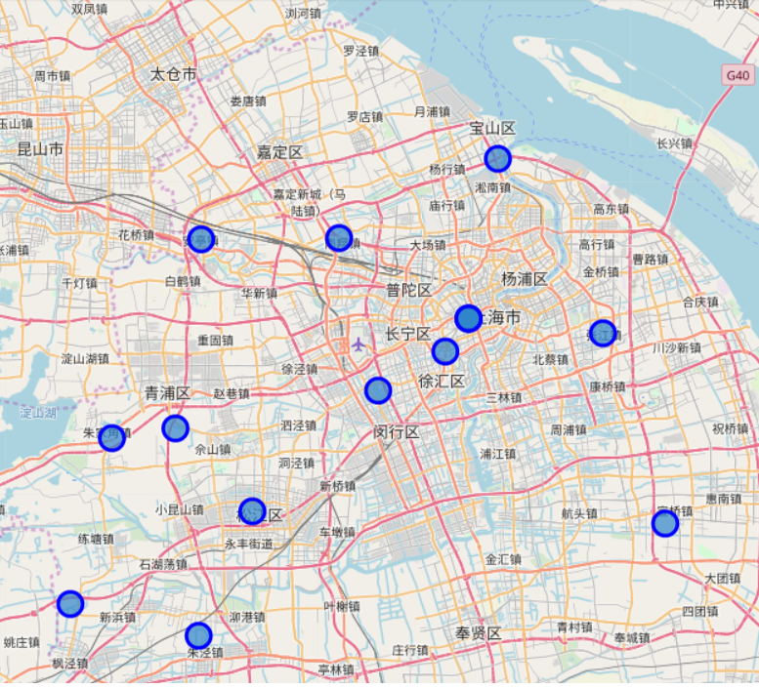
Neighborhoods in shanghai

Slide 11
3.4 Obtain the venue data for the neighborhoods from Foursquare API and categorize the venues by parking time length
Define Foursquare Credentials and Version.
Download venue information in each neighborhood via Foursquare API. Convert the venues list into a new data frame and combine with data frame of neighborhoods.
Count the number of main venue types with descend order and select top-10 venue types by numbers for data analyze.
Then categorized data into three types with different general parking time. Note that in these venue types, "Shopping Mall, Hotel, Park" are venues longer parking hours

Slide 12
Con’t Special note for categrization
"Spa, Dumpling Restaurant, Chinese Restaurant, Japanese Restaurant" are venues Medium parking hours "Cocktail Bar, Bakery, Coffee Shop" are venues shorter parking hours or no parking places. Then cluster the neighborhoods by above venue characteristics by Sklearn Kmeans with k=3 and random_state=0. Then create a new data frame that includes the cluster as well as the top 10 venues for each neighborhood with latitude and longitude data. Use this result data frame to create a new map with clusters in different color.

Slide 13
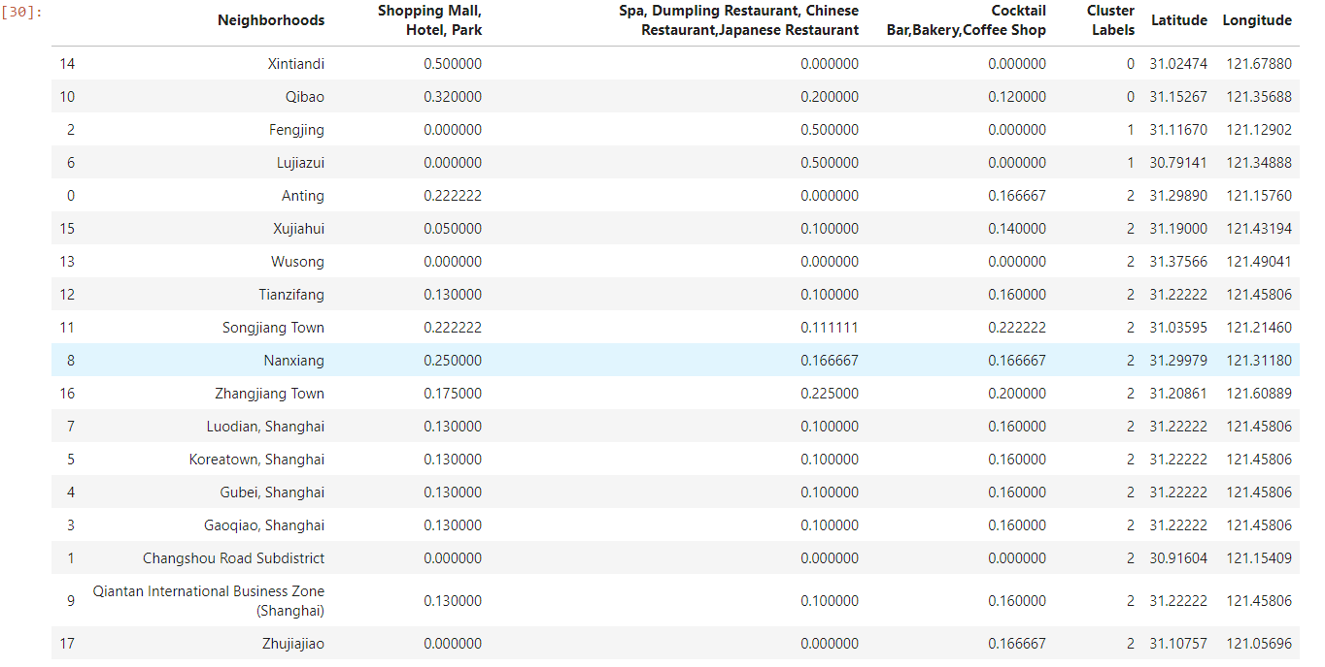
Categorized chart

Slide 14
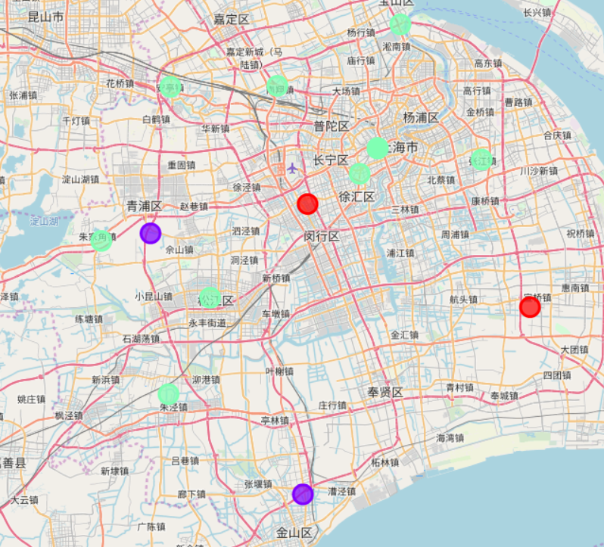
Neighborhoods with cluster point

Slide 15
4. Analyze the result and make decision

Slide 16
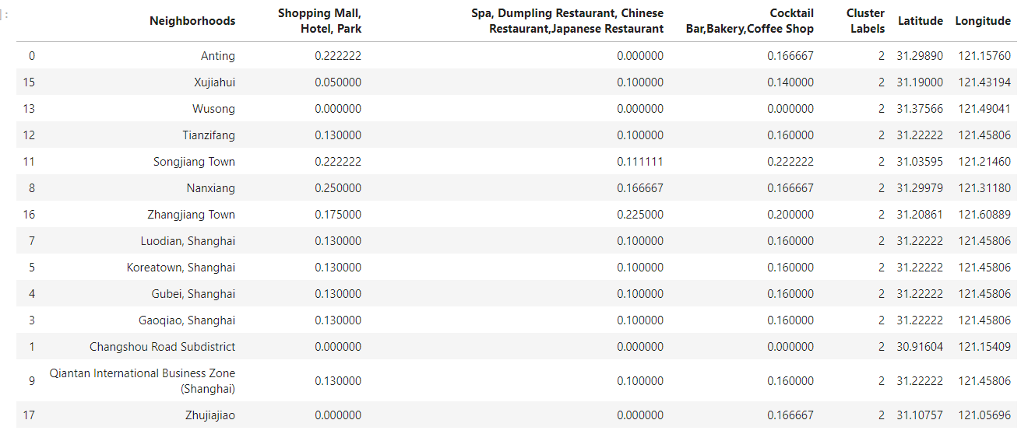
Cluster 2: neighborhoods where longer, medium and shorter parking time places are relatively in average number.
These neighborhoods are usually downtown neighborhoods.
All kinds of business overlapped with each other
parking space are usually limited ->public transportations are usually the first priority
Fair Choice

Slide 17
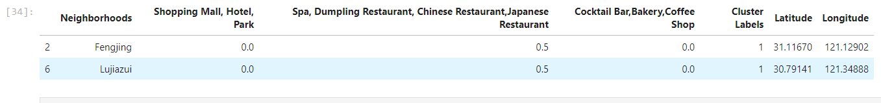
Cluster 1 are usually residential area
The most popular business here are restaurants
Closed to living areas, do not provides parking spaces.
Electrical cars owner will prefer to charge their cars in their own parking lot.
Bad Choice

Slide 18
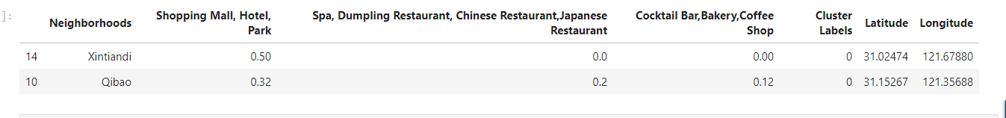
Cluster 0 : New district
High occurrence of Shopping Mall, Hotel, Park.
Away from downtown places, public transportation are not covered thoroughly
People will choose drive to these neighborhoods
Stay for rather a long time(> 4 hour)
Good Choice

Slide 19
5. Discussion
Once budget and human resource are available, the next stage with more location need to be considered.
We should move to cluster 2 to find new neighborhoods.
The higher normalized value in Shopping Mall, Hotel, Park should be preferred to build new charging station.
Anting, Songjiang Town, Nanxiang

Slide 20
6. Conclusion
In the first stage, the neighborhoods to build electrical charging stations are Xintiandi, Qibao.
In the second stage, Anting, Songjiang Town, Nanxiang are good choices to build electrical charging stations.

